Slide 1
Stefen Rice
“I firmly believe that any man's finest hour, the greatest fulfillment of all that he holds dear, is that moment when he has worked his heart out in a good cause and lies exhausted on the field of battle - victorious.” Vince Lombardi

Slide 2
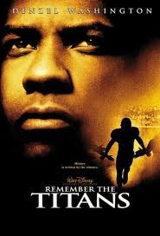
Remember The Titans, Coach Boon’s speech
This is an excerpt from the movie Remember the Titans released on September 29th, 2000, starting Denzel Washington and produced by Jerry Bruckheimer and Walt Disney Pictures. Coach Boone brings the team to the place where the Civil War battle of Gettysburg was fought. His goal was to show the team if they didn’t come together regardless of their race, they too will be destroyed by hatred.
(Google Images)

Slide 3
Works Cited
Remember The Titans. Dir. Biaz Yakin. Perf. Denzel Washington. Walt Disney Pictures, 2000. Film.
Pictures- Google Images
Quote from Vince Lombardi. Retrieved from:
http://www.brainyquote.com/quotes/keywords/lies_2.html

Slide 4
